Slide 1
PAN Card Tampering Detection using Machine Learning Techniques

Slide 2
Abstract
The PAN Card Tampering Detection System using Machine Learning is designed to detect forged PAN cards using image processing and deep learning techniques. It utilizes OCR for text extraction, CNNs for forgery detection, and facial recognition to verify identity. The system efficiently identifies altered details, manipulated images, and signature mismatches in PAN cards. Preprocessing techniques enhance OCR accuracy, while deep learning models classify tampered vs. genuine documents. This solution is fast, scalable, and highly accurate, making it ideal for banks, financial institutions, and government agencies. It enhances fraud prevention by providing automated, real-time verification. Future improvements include blockchain-based identity verification and AI-driven deepfake detection.

Slide 3
Introduction
Identity fraud is a major concern in financial and government sectors, with PAN card forgery being a common issue. This project automates PAN card verification using machine learning and image processing techniques. It employs OCR for text extraction, CNNs for forgery detection, and facial recognition for identity verification. The system efficiently detects text modifications, image tampering, and signature mismatches. By providing fast, accurate, and real-time fraud detection, it helps banks, financial institutions, and government agencies. The project enhances security and reliability in identity verification. Future improvements include blockchain integration and AI-driven deepfake detection. Identity fraud is a major concern in financial and government sectors, with PAN card forgery being a common issue. This project automates PAN card verification using machine learning and image processing techniques. It employs OCR for text extraction, CNNs for forgery detection, and facial recognition for identity verification. The system efficiently detects text modifications, image tampering, and signature mismatches. By providing fast, accurate, and real-time fraud detection, it helps banks, financial institutions, and government agencies. The project enhances security and reliability in identity verification. Future improvements include blockchain integration and AI-driven deepfake detection.

Slide 4
Existing System
The current PAN card verification process is mostly manual, time-consuming, and error-prone. Officials check documents visually, making it difficult to detect high-quality forgeries and tampered details. Traditional OCR-based methods lack accuracy in extracting text from blurred or low-quality images. There is no automated mechanism to verify altered signatures, manipulated photos, or text modifications. Due to these limitations, fraudulent PAN cards often go undetected, leading to identity theft and financial fraud.

Slide 5
Proposed System
The proposed system automates PAN card verification using machine learning and deep learning techniques. It employs OCR for accurate text extraction, CNNs for forgery detection, and facial recognition for identity verification. The system can identify tampered details, altered images, and mismatched signatures with high accuracy. It provides fast, real-time fraud detection for banks, financial institutions, and government agencies. This solution enhances security, reduces manual errors, and prevents identity fraud effectively.

Slide 6
LITERATURE REVIEW
Several research studies focus on document forgery detection using image processing and deep learning. Traditional OCR-based methods struggle with accuracy in detecting altered text and images. Recent advancements in CNNs and deep learning models have improved fraud detection in identity documents. Studies show that AI-driven tampering detection enhances security and reduces manual verification errors. This project builds upon existing research by integrating OCR, CNNs, and facial recognition for robust PAN card verification.

Slide 7
Modules for PPT
Data Preprocessing – The system begins with image preprocessing techniques such as grayscale conversion, noise removal, and contrast enhancement to improve OCR accuracy and feature extraction. This ensures that text and visual elements are clearly distinguishable for analysis.
Feature Extraction & Classification – Key features such as text patterns, fonts, signatures, and facial images are extracted using OCR, edge detection, and CNN-based feature maps. These extracted features are then classified using machine learning models to detect forgeries or tampered PAN cards.
RGB Composite & Band Selection – The system uses RGB image processing and multi-band selection techniques to analyze color distortions and manipulated regions in the document. This helps in identifying altered areas, hidden modifications, and inconsistencies in the PAN card.
Interactive Visualization – An interactive dashboard displays the processed PAN card image, highlighting suspicious areas such as text modifications, signature mismatches, or facial inconsistencies. This visualization aids in quick fraud detection and enhances the decision-making process.
Model Deployment & Performance Analysis – The final model is deployed using Flask/FastAPI for real-time fraud detection. Performance is evaluated using precision, recall, F1-score, and confusion matrix to ensure high accuracy and reliability in detecting forged PAN cards.

Slide 8
Algorithms Used for PPT 1. Convolutional Neural Networks (CNNs): CNNs are used for image-based forgery detection, extracting key features like text, signature, and photo anomalies. Layers such as convolution, pooling, and fully connected layers help in identifying tampered sections in PAN cards with high accuracy. 2. Principal Component Analysis (PCA) : PCA is applied for dimensionality reduction, enhancing model efficiency by selecting the most important features from images. This helps in removing redundant data and improving classification accuracy. 3. Softmax Classifier : The Softmax classifier is used in the final decision-making layer to categorize PAN cards as genuine or tampered. It assigns probability scores to different classes, ensuring accurate classification of document authenticity. 4. Data Augmentation Techniques : Techniques like rotation, flippig, contrast adjustment, and noise addition are used to generate diverse training data. This prevents overfitting and improves the model's ability to detect forgeries under different conditions. 5. Adam Optimizer & Cross-Entropy Loss : The Adam optimizer ensures fast and efficient learning, adjusting model weights dynamically. Cross-entropy loss measures classification errors, helping in refining the model for higher accuracy and reliability.

Slide 9
Software Components
Programming Language: Python 3.9+ (For Machine Learning & Image Processing)
Frameworks & Libraries:
TensorFlow/Keras or PyTorch – Used for training deep learning models (CNNs).
OpenCV – Used for image preprocessing, feature extraction, and forgery detection.
Scikit-learn – Used for machine learning classification and performance evaluation.
Pandas & NumPy – Used for data handling, manipulation, and feature engineering.
Matplotlib & Seaborn – Used for data visualization and result analysis.
Streamlit – Used for developing an interactive web-based forgery detection interface.
Hardware Components
Processor: Intel i5/i7 or AMD Ryzen 5/7 (Minimum Quad-Core)
RAM: 8GB (16GB+ Recommended for Deep Learning)
Storage: 256GB SSD (512GB+ Recommended for Faster Data Processing)
GPU (Highly Recommended): NVIDIA GTX 1650 / RTX 3060+ for faster model training
Cloud GPU (Optional for Deployment): Google Colab, AWS EC2, or Google Cloud TPU for scalable deployment

Slide 10
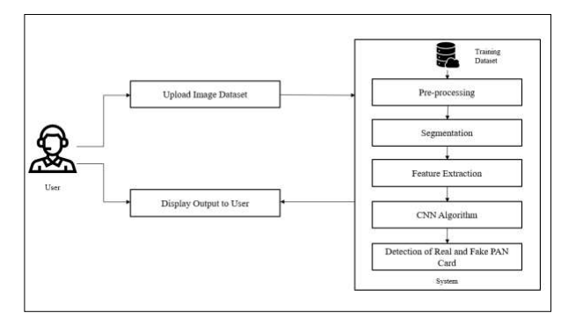
Block Diagram

Slide 11
UML Diagrams
Use Case Diagram
Data Flow Diagram
Sequence Diagram
State Diagram

Slide 12
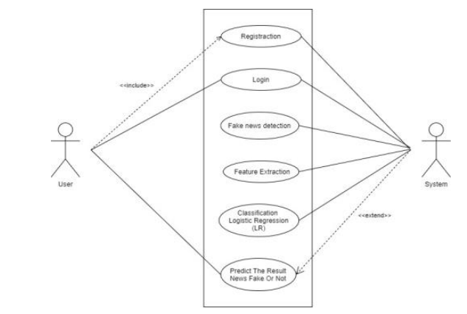
Use case Diagrams

Slide 13
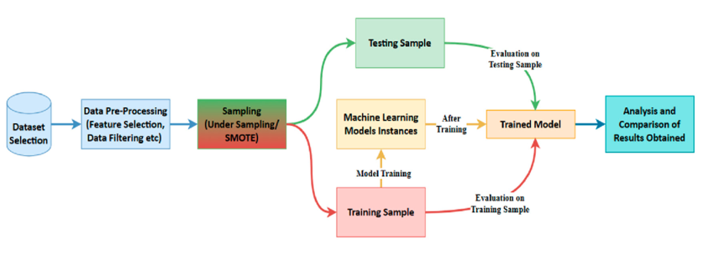
Data Flow Diagrams

Slide 14
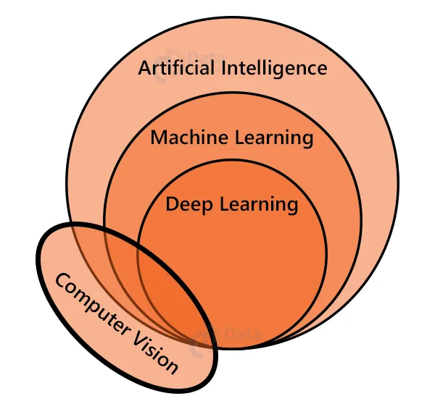
Sequance Diagrams

Slide 15
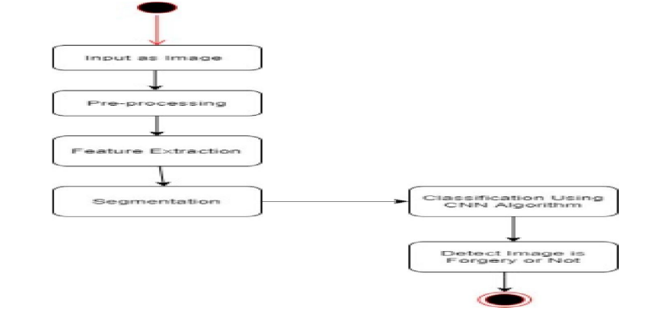
Active Diagrams

Slide 16
Final Output
The final output of the PAN Card Tampering Detection System is a highly accurate fraud detection model that identifies forged PAN cards using machine learning and deep learning techniques. The system successfully extracts text, facial features, and signatures from PAN card images using OCR and OpenCV. It then analyzes the extracted data with Convolutional Neural Networks (CNNs) to classify whether the document is genuine or tampered. The model generates a detailed forgery detection report, highlighting altered regions, mismatched signatures, or manipulated images using heatmaps and bounding boxes. The system also provides an interactive web-based interface (using Streamlit) for real-time verification, making it a fast, scalable, and efficient solution for banks, financial institutions, and government agencies. This automated process eliminates manual errors, enhances security, and helps prevent identity fraud and financial scams.

Slide 17


Final Output

Slide 18
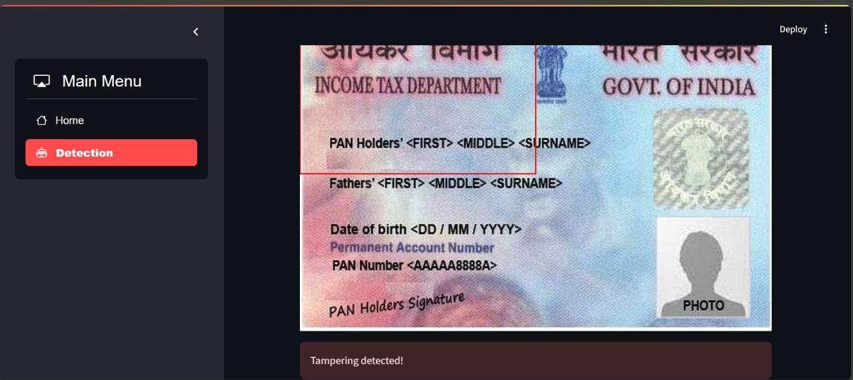
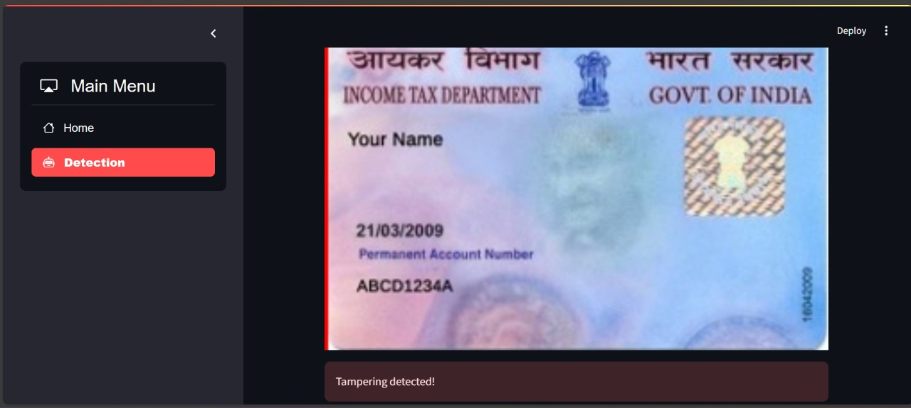
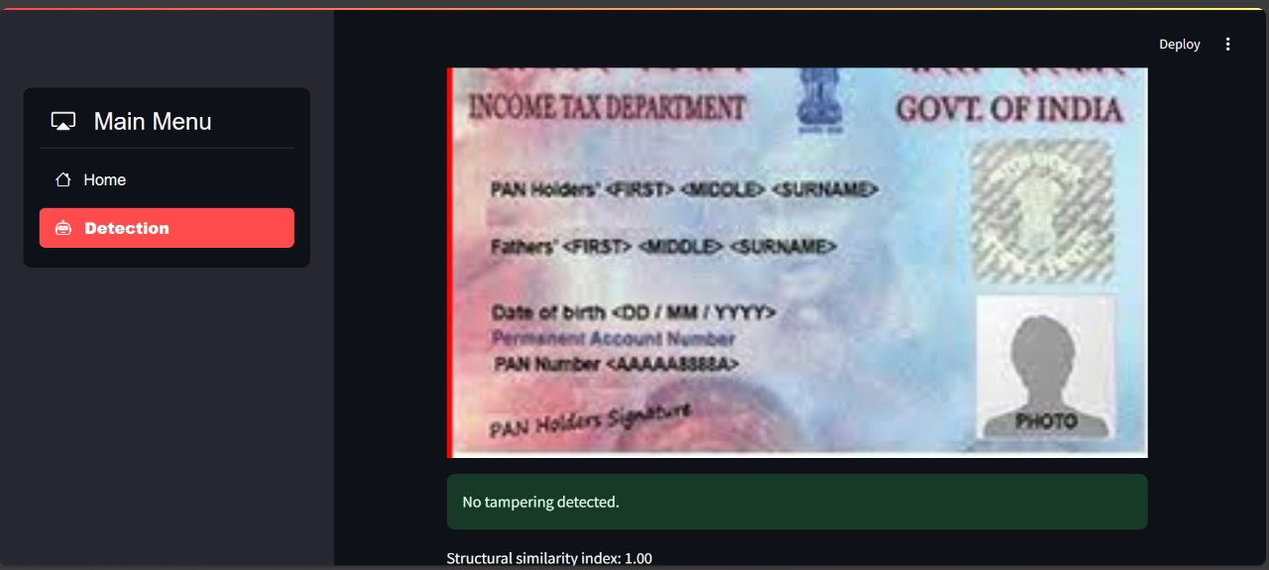
Final Output

Slide 19
Conclusion
The PAN Card Tampering Detection System provides an efficient, accurate, and automated solution for detecting forged PAN cards using machine learning and deep learning techniques. By integrating OCR, CNNs, and image processing, the system successfully identifies altered text, manipulated images, and signature mismatches. This project significantly reduces manual verification efforts, enhances fraud prevention, and ensures secure identity verification for financial institutions and government agencies. The use of deep learning models, real-time analysis, and an interactive interface makes it a scalable and reliable solution for fraud detection. Future enhancements could include blockchain-based identity validation and AI-driven deepfake detection for even stronger security measures.

